Slide 1
System Security
Including OS Security
Mostly based on
“Analyzing Computer Security” [Pfleeger & Pfleeger]
Pearson Education

Slide 2
What we mean by Security?
Protection of assets
Can take several forms:
Prevention
Detection
Reaction

Slide 3
Vulnerabilities, Threats, and Controls
Vulnerability = A weakness in a security system
Threat = Circumstances that have a potential to cause harm
Controls = Means and ways to block a threat, which tries to exploit one or more vulnerabilities

Slide 4
Examples of Security Violations
User A transmits a file to user B.
The file contains sensitive information (e.g. payroll records) that is to be protected from disclosure.
User C, who is not authorized to read the file, is able to monitor the transmission and captures a copy of the file during its transmission.

Slide 5
Examples of Security Violations
A network management application, D, transmits a message to a computer, E, under its management.
The message instructs computer E to update an authorization file to include the identities of a number of new users who are to be given access to that computer.
User F intercepts the message, alters its contents to add or delete entries, and then forwards the message to E, which accepts the message as coming from the manager D and updates its authorization file accordingly.

Slide 6
Examples of Security Violations
An employee is fired without warning.
The personnel manager sends a message to a server system to invalidate the employee’s account.
When the invalidation is accomplished, the server is to post a notice to the employee’s file as confirmation of the action.
The employee is able to intercept the message and delay it long enough to make a final access to the server to retrieve sensitive information.
The message is then forwarded, the action is taken, and the confirmation posted. The employee’s action may go unnoticed for some considerable time.

Slide 7
Examples of Security Violations
A message is sent from a customer to a stockbroker with instructions for various transactions.
Subsequently, the investments lose value and the customer denies sending the message.

Slide 8
Attack
Materialization of a vulnerability / threat combination
Exploitation of one or more vulnerabilities by a threat
Tries to defeat controls
Attack may be:
Successful (a.k.a. an exploit)
Resulting in a breach of security, a system penetration, etc.
Unsuccessful
When controls block a threat trying to exploit a vulnerability

Slide 9
Attacks
Passive
Active
Interception
(confidentiality)
Interruption
(availability)
Modification
(integrity)
Fabrication
(integrity)
Release of
Message
contents
Traffic
analysis

Slide 10
Types of Attackers
Types of Attackers - Classification 1
Amateurs
Opportunistic attackers (use a password they found)
Script kiddies
Hackers - nonmalicious
In broad use beyond security community: also malicious
Crackers – malicious
Career criminals
State-supported spies and information warriors
Types of Attackers - Classification 2
Recreational hackers / Institutional hackers
Organized criminals / Industrial spies / Terrorists
National intelligence gatherers / Info warriors

Slide 11
Attack Motive
Attacking for challenge/power
Some enjoy intellectual challenge of defeating supposedly undefeatable
Successful attacks give them sense of power
Not much challenge for vast majority of hackers
Just replay well-known attacks using scripts
Attacking for fame
Some not satisfied with challenge only
Want recognition – even if by pseudonym only
Thrilled to see their pseudonym in media
Attacking for money/espionage
Attacking for direct financial gains
Attacking to improve competitiveness of ones comp/org
(cont.)

Slide 12
Attack Motive …
Attacking to spy on/harm another country
Espionage and information warfare
Steal secrets, harm defense infrastructure, etc.
Attacking to improve competitiveness of ones country
Some countries support industrial espionage to aid their own industries
Few reliable statistics – mostly perceptions of attacks
Attacking to promote ideology
Two types of ideological attacks:
Hactivism
Disrupting normal operation w/o causing serious damage
Cyberterrorism
Intent to seriously harm
Including loss of life, serious economic damage

Slide 13
Example: Hacking As Social Protest
DDOS attacks on government agencies
SPAM attacks as “retaliation”
In the lead up to the Pyeongchang Winter Olympics (Feb 2018), Russian hackers launched a number of related cyberattacks as retaliation for the country's doping ban from the games.
https://ccdcoe.org/uploads/2018/10/12_NAZARIO-Politically-Motivated-DDoS.pdf doi: 10.3233/978-1-60750-060-5-163
https://www.cloudflare.com/learning/ddos/famous-ddos-attacks/
https://github.blog/2018-03-01-ddos-incident-report/
https://securelist.com/ddos-report-q1-2019/90792/
https://www.csoonline.com/article/2133139/spam-fighter--spammer-spat-becomes-massive-ddos-attack.html
https://www.wired.com/story/worst-hacks-2018-facebook-marriott-quora/

Slide 14
Threat Spectrum
Local threats
Recreational hackers
Institutional hackers
Shared threats
Organized crime
Industrial espionage
Terrorism
National security threats
National intelligence
Info warriors

Slide 15
Kinds of Threats
Interception
an unauthorized party (human or not) gains access to an asset
Interruption
an asset becomes lost, unavailable, or unusable
Modification
an unauthorized party changes the state of an asset
Fabrication
an unauthorized party counterfeits an asset

Slide 16
Levels of Vulnerabilities / Threats
For other assets (resources)
including. people using data, s/w, h/w
For data
“on top” of s/w, since used by s/w
For software
“on top” of h/w, since run on h/w
For hardware

Slide 17
A) Hardware Level of Vulnerabilities / Threats
Add / remove a hardware device
Ex: Snooping, wiretapping
Ex: Modification, alteration of a system
Physical attacks on hardware => need physical security: locks and guards
Accidental (dropped PC box) or voluntary (bombing a computer room)
Theft / destruction
Damage the machine (spilled coffe, mice, real bugs)
Steal the machine
Hammer the machine

Slide 18
Example of Snooping
Wardriving / Warwalking – Driving or Walking around with a wireless enabled machine to look for unsecured wireless LANs.
Warchalking -- using chalk markings to show the presence and vulnerabilities of wireless networks nearby
e.g. indicating WEP protected or protected WLAN

Slide 19
B) Software Level of Vulnerabilities / Threats
Software Deletion
Easy to delete needed software by mistake
To prevent this: use configuration management software
Software Modification
Trojan Horses, Viruses, Logic Bombs, Trapdoors, Information Leaks (via covert channels), ...
Software Theft
Unauthorized copying
via P2P, etc.

Slide 20
Types of Malicious Code
Bacterium - A specialized form of virus which does not attach to a specific file. Usage obscure.
Logic bomb - Malicious [program] logic that activates when specified conditions are met. Usually intended to cause denial of service or otherwise damage system resources.
Trapdoor - A hidden computer flaw known to an intruder, or a hidden computer mechanism (usually software) installed by an intruder, who can activate the trap door to gain access to the computer without being blocked by security services or mechanisms.
Trojan horse - A computer program that appears to have a useful function, but also has a hidden and potentially malicious function that evades security mechanisms, sometimes by exploiting legitimate authorizations of a system entity that invokes the program.
Virus - A hidden, self-replicating section of computer software, usually malicious logic, that propagates by infecting (i.e., inserting a copy of itself into and becoming part of) another program. A virus cannot run by itself; it requires that its host program be run to make the virus active.
Worm - A computer program that can run independently, can propagate a complete working version of itself onto other hosts on a network, and may consume computer resources destructively.
[cf. http://www.ietf.org/rfc/rfc2828.txt]
Notes:
25

Slide 21
Intent
All malicious code can be evaluated in the context of three principles allowing for successful countermeasures
Delivery Method or System Access,
Trigger or Initiation Mechanism,
Payload or effect on system

Slide 22
C) Data Level of Vulnerabilities / Threats
How valuable is your data?
Credit card info vs. your home phone number
Source code
Visible data vs. context
Adequate protection
Cryptography
Good if intractable for a long time
Threat of Identity Theft

Slide 23
Methods of Defense
Five basic approaches to defense of computing systems
Prevent attack
Block attack / Close vulnerability
Deter attack
Make attack harder (But attack can’t be made impossible)
Deflect attack
Make another target more attractive than this target
Detect attack
During or after
Recover from attack

Slide 24
Controls
Can be applied at hardware, software, physical or polices.
Simple mechanisms or lots of features?
Should defining and enforcing security mechanism be a centralized function?
How to prevent access to the layer below the security mechanism?

Slide 25
Multiple controls in computing systems
Include:
system perimeter – defines “inside/outside”
preemption – attacker scared away
deterrence – attacker could not overcome defenses
faux environment (e.g. honeypot, sandbox) – attack deflected towards a worthless target (but the attacker doesn’t know about it!)
Note layered defense /
multilevel defense / defense in depth (ideal!)

Slide 26
Examples of Controls
Modern cryptology
Encryption, authentication code, digital signature etc.
Software controls
Standard development tools (design, code, test, maintain etc)
Operating systems controls
Internal program controls (e.g: access controls to data in a database)
Firewalls

Slide 27
Security Goals
Basic Components of Security:
Confidentiality (Secrecy or Privacy) – assets accessed only by authorized parties
Not only reading but viewing, printing or knowing about the asset
Integrity – assets modified only by authorized parties
Includes writing, changing, changing the status, deleting or creating
Availability – assets are accessible to authorized parties at appropriate times.
Denial of Service

Slide 28
Confidentiality, Integrity, Availability (CIA)
CIA
Confidentiality: Who is authorized to use data?
Integrity: Is data “good?”
Availability: Can access data whenever need it?
C
I
S
Other security components added to CIA)
Authentication
Authorization
Non-repudiation
…
A
S = Secure

Slide 29
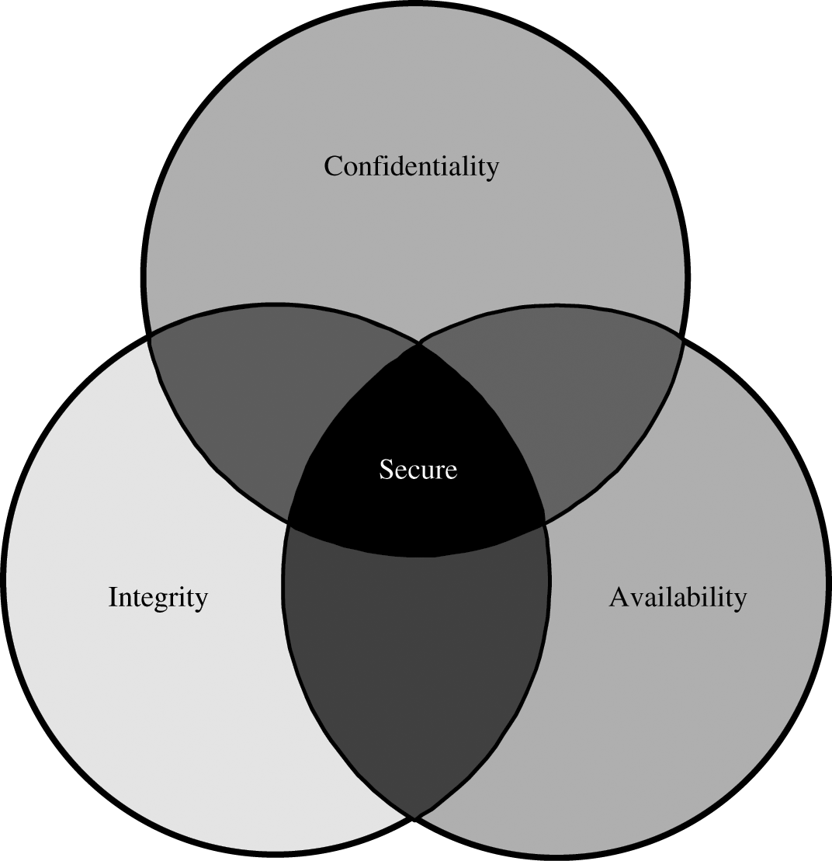
CIA Triad

Slide 30
Need to Balance CIA
Example 1: C vs. I+A
Disconnect computer from Internet to increase confidentiality
Availability suffers, integrity suffers due to lost updates
Example 2: I vs. C+A
Have extensive data checks by different people/systems to increase integrity
Confidentiality suffers as more people see data, availability suffers due to locks on data under verification)
Notes:
In addition to all the rules and regulations, policies and procedures and the related system specific documentation, there are some current computer security issues of which you as the Executive should be made aware.

Slide 31
Confidentiality
“Need to know” basis for data access
How do we know who needs what data?
Approach: access control specifies who can access what
How do we know a user is the person she claims to be?
Need her identity and need to verify this identity
Approach: identification and authentication
Confidentiality is:
difficult to ensure
easiest to assess in terms of success (binary in nature: Yes / No)

Slide 32
Integrity
Integrity vs. Confidentiality
Concerned with unauthorized modification of assets
Confidentiality - concered with access to assets
Integrity is more difficult to measure than confidentiality
Context-dependent - means different things in different contexts
Could mean any subset of these asset properties:
{ precision / accuracy / currency / consistency /
meaningfulness / usefulness / ...}

Slide 33
Availability (1)
Again Difficult
Full implemenation of availability for Internet users with ensuring security
Complex
Context-dependent
Could mean any subset of these asset (data or service) properties :
{ usefulness / sufficient capacity /
progressing at a proper pace /
completed in an acceptable period of time / ...
}

Slide 34
Availability (2)
An asset (resource) is available if:
Timely request response
Fair allocation of resources (no starvation!)
Fault tolerant (no total breakdown)
Easy to use in the intended way
Provides controlled concurrency (concurrency control, deadlock control, ...)

Slide 35
Who attacks networks?
Who are the attackers?
There is no name list
Who the attackers might be?
MOM = Method / Opportunity / Motive

Slide 36
Security Methods of Operating Systems
The basis of protection is separation:
keeping one user's objects separate from other users
separation in an operating system can occur in several ways:
physical separation: processes use different physical objects, such as separate printers
temporal separation: processes are executed at different times
logical separation: users operate under the illusion that no other processes exist, as when an operating system constrains a program's accesses so that the program cannot access objects outside its permitted domain
cryptographic separation, in which processes conceal their data and computations in such a way that they are unintelligible to outside processes
Combinations.

Slide 37
Control of Access to General Objects
Protecting memory is a specific case of the more general problem of protecting objects.
Protection is desirable for:
memory
a file or data set on an auxiliary storage device
an executing program in memory
a directory of files
a hardware device
a data structure, such as a stack
a table of the operating system
instructions, especially privileged instructions
passwords and the user authentication mechanism
the protection mechanism itself

Slide 38
Role-Based Access Control
Role-based access control lets us associate privileges with groups i.e. who can and who cannot do something
We want some users (such as administrators) to have significant privileges, and we want others (such as regular users or guests) to have lower privileges

Slide 39
User Authentication
Authentication mechanisms use any of three qualities to confirm a user's identity.
Something the user knows. Passwords, PIN numbers, passphrases, a secret handshake, and mother's maiden name are examples of what a user may know.
Something the user has. Identity badges, physical keys, a driver's license, or a uniform are common examples of things people have that make them recognizable.
Something the user is. These authenticators, called biometrics, are based on a physical characteristic of the user, such as a fingerprint, the pattern of a person's voice, or a face (picture).
Two or more forms can be combined for more solid authentication (bank card + PIN)

Slide 40
Passwords as Authenticators
The most common authentication mechanism for user to operating system is a password
a "word" known to computer and user
Human practice sometimes degrades its quality
Even though they are widely used, passwords suffer from some difficulties of use:
Loss. it is possible that no one will be able to replace a lost or forgotten password.
Use. Supplying a password for each access to a file can be inconvenient and time consuming.
Disclosure. If a password is disclosed to an unauthorized individual, the file becomes immediately accessible.
Revocation. To revoke one user's access right to a file, someone must change the password.

Slide 41
Additional Authentication Information
In addition to the name and password, we can use other information available to authenticate users.
Suppose Adams works in the accounting department during the shift between 8:00 a.m. and 5:00 p.m., Monday through Friday.
Any legitimate access attempt by Adams should be made during those times, through a workstation in the accounting department offices
By limiting Adams to logging in under those conditions, the system protects against two problems:
Someone from outside might try to impersonate Adams. This attempt would be thwarted by either the time of access or the port through which the access was attempted
Adams might attempt to access the system from home or on a weekend, planning to use resources not allowed or to do something that would be too risky with other people around.
Using additional authentication information is called multifactor authentication

Slide 42
Attacks on Passwords
Here are some ways you might be able to determine a user's password, in decreasing order of difficulty.
Try all possible passwords.
Try frequently used passwords.
Try passwords likely for the user.
Search for the system list of passwords.
Ask the user.

Slide 43
Loose-Lipped Systems
The system might expose information to intruders
If the user enters a wrong username or password
WELCOME TO THE XYZ COMPUTING SYSTEMS
ENTER USER NAME: adams
INVALID USER NAME UNKNOWN USER
ENTER USER NAME:
An alternative arrangement of the login sequence is shown below.
WELCOME TO THE XYZ COMPUTING SYSTEMS
ENTER USER NAME: adams
ENTER PASSWORD: john
INVALID ACCESS
ENTER USER NAME:
ENTER PASSWORD
In this way, the intruder does not know which failed.

Slide 44
Exhaustive Attack
In an exhaustive or brute force attack, the attacker tries all possible passwords
in some automated fashion
Depends on the implementation of the computing system
The passwords contain letters, numbers, special symbols, etc
For example, if passwords are words consisting of the 26 characters AZ and can be of any length from 1 to 8 characters
there are 26¹ passwords of 1 character, 26² passwords of 2 characters
26⁸ passwords of 8 characters.
Therefore, the system as a whole has 26¹ + 26² + ... + 26⁸ = 26⁹ - 1 5 * 10¹² or five million possible passwords.
That number seems intractable enough.
If we were to use a computer to create and try each password at a rate of checking one password per millisecond, it would take on the order of 150 years to test all passwords.
But if we can speed up the search to one password per microsecond, the work factor drops to about two months.

Slide 45
Exhaustive Attack (Ex)
For example, if passwords are words consisting of the 26 characters AZ and can be of any length from 1 to 8 characters
There are 26¹ passwords of 1 character, 26² passwords of 2 characters, 26⁸ passwords of 8 characters.
Therefore, the system as a whole has 26¹ + 26² + ... + 26⁸ = 26⁹ - 1 5 * 10¹² or five million possible passwords.
That number seems intractable enough.
If we were to use a computer to create and try each password at a rate of checking one password per millisecond, it would take on the order of 150 years to test all passwords.
But if we can speed up the search to one password per microsecond, the work factor drops to about two months.
This amount of time is reasonable if the reward is large

Slide 46
Exhaustive Attack
Searching for a single particular password does not necessarily require all passwords to be tried;
An intruder needs to try only until the correct password is identified
If the set of all possible passwords were evenly distributed, an intruder would likely need to try only half of the password space (on average)
This feature reduces the size of the password space

Slide 47
Probable Passwords
Think of a word ???
Is the word you thought of long?
Is it uncommon?
Is it hard to spell or to pronounce?
The answer to all three of these questions is probably no.
People tend to choose names or words they can remember
Penetrators searching for passwords realize these very human characteristics
If people prefer short passwords to long ones
The penetrator will plan to try all passwords but to try them in order by length
There are only 26¹ + 26² + 26³=18,278 passwords of length 3 or less
At the assumed rate of one password per millisecond, all of these passwords can be checked in 18.278 seconds, hardly a challenge with a computer
Even expanding the tries to 4 or 5 characters raises the count only to 475 seconds (about 8 minutes) or 12,356 seconds (about 3.5 hours), respectively.
One contains a dictionary of 80,000 words. Trying all of these words as passwords takes only 80 seconds

Slide 48
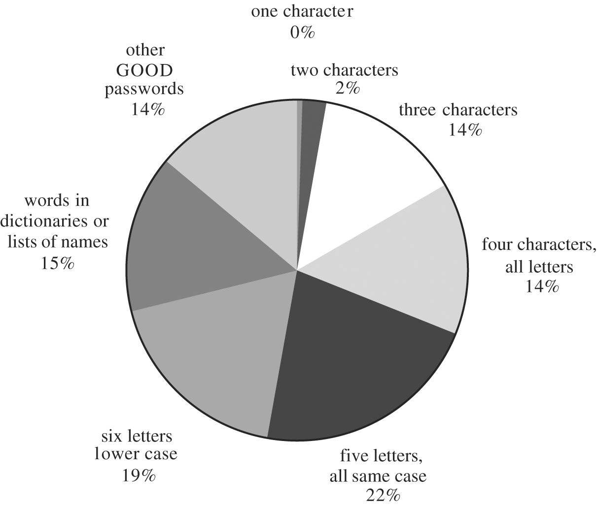
Passwords Likely for a User
People typically choose personal passwords
name of a spouse, a child, a brother or sister, a pet, a street name, or something memorable or familiar
Distribution of Password Types

Slide 49
Passwords Likely for a User
People typically choose personal passwords
Name of a spouse, a child, a brother or sister, a pet, a street name, or something memorable or familiar
Of those passwords, 86 percent could be uncovered in about one week's worth of 24-hour-a-day testing, using the very generous estimate of 1 millisecond per password check.

Slide 50
Plaintext System Password List
An attacker may target the system password file
On some systems, the password list could be a file, organized essentially as a two-column table of user IDs and corresponding passwords.

Slide 51
Plaintext System Password List
Protect the table with strong access controls, limiting access to the operating system.
Not every operating system module needs or deserves access to this table
For example, the operating system scheduler, accounting routines, or storage manager have no need to know the table's contents.
The operating system is not partitioned, so all its modules have access to all privileged information
This monolithic view of the operating system implies that a user who exploits a flaw in one section of the operating system has access to all the system's deepest secrets.
A better approach is to limit table access to the modules that need access: the user authentication module and the parts associated with installing new users, for example.

Slide 52
Plaintext System Password List
If the table is stored in plain sight, an intruder can simply dump memory at a convenient time to access it. Careful timing may enable a user to dump the contents of all of memory and, by exhaustive search, find values that look like the password table.
System backups can also be used to obtain the password table.
Backups often contain only file contents, with no protection mechanism to control file access
Finally, the password file is a copy of a file stored on disk. Anyone with access to the disk or anyone who can overcome file access restrictions can obtain the password file.

Slide 53
Encrypted Password File
There is an easy way to foil an intruder seeking passwords in plain sight: encrypt them
When a user's password is received, the stored password is decrypted, and the two are compared.
Even with encryption, there is still a slight exposure because for an instant the user's password is available in plaintext in main memory.
A safer approach uses one-way encryption
The password table's entries are encrypted by a one-way encryption and then stored
When the user enters a password, it is also encrypted and then compared with the table
If the two values are equal, the authentication succeeds
With one-way encryption, the password file can be stored in plain view
the password table for the Unix operating system can be read by any user unless special access controls have been installed

Slide 54
Encrypted Password File
There is always the possibility that two people might choose the same password
creating two identical entries in the password file
For instance, if Bill and Kathy both choose their passwords on April 1, they might choose same password. Bill might read the password file and notice that the encrypted version of his password is the same as Kathy's.
Unix+ circumvents this vulnerability by using a password extension, called the salt.
The salt is a 12-bit number formed from the system time and the process identifier
the salt is likely to be unique for each user, and it can be stored in plaintext in the password file
The salt is concatenated to Bill's password (pw) when he chooses it and E(pw+salt_{B}) is stored for Bill, and his salt value is also stored
When Kathy chooses her password, the salt is different because the time or the process number is different. Call this new one salt_{K} ;For her, E(pw+salt_{K}) and salt_{K} are stored

Slide 55
Encrypted Password File
When either person tries to log in
the system fetches the appropriate salt from the password table
combines that with the password before performing the encryption
The encrypted versions because of salt are very different for these two users
When Bill looks down the password list, the encrypted version of his password will not look at all like Kathy's
Storing the password file in a disguised form relieves much of the pressure to secure it
Better still is to limit access to processes that legitimately need access
In this way, the password file is protected to a level commensurate with the protection provided by the password itself
Someone who has broken the controls of the file system has access to data, not just passwords, and that is a serious threat

Slide 56
Indiscreet Users
But there is a simple way to obtain a password: Get it directly from the user
People often tape a password to the side of a terminal or write it on a card just inside the top desk drawer
Users are afraid they will forget their passwords, or they cannot be bothered trying to remember them
two-thirds of people approached on the street volunteered to disclose their password for a coupon good for a cup of coffee, and 79 percent admitted they used the same password for more than one system or web site

Slide 57
Probable Passwords
The COPS, Crack, and SATAN utilities allow an administrator to scan a system for weak passwords.
People think they can be clever by picking a simple password and replacing certain characters, such as 0 (zero) for letter O, 1 (one) for letter I or L, 3 (three) for letter E or @ (at) for letter A.
But users aren't the only people who could think up these substitutions.
Guessing steps: no password, same as user ID, derived from the user name, common word list, use dictionary, and brute force.

Slide 58
The Top 10 Passwords in 2018
123456
password
123456789
12345678
12345
111111
1234567
sunshine
qwerty
iloveyou

Slide 59
Password Selection Criteria
At the RSA Security Conference in 2006, Bill Gates, head of Microsoft, described his vision of a world in which passwords would be obsolete
So what can we conclude about passwords? They should be hard to guess and difficult to determine exhaustively, we present several guidelines for password selection:
Use characters other than just AZ
Choose long passwords
Avoid actual names or words
Choose an unlikely password
Change the password regularly
Don't write it down
Don't tell anyone else

Slide 60
One-Time Passwords
A one-time password is one that changes every time it is used
Instead of assigning a static phrase to a user, the system assigns a static mathematical function.
The system provides an argument to the function, and the user computes and returns the function value
Such systems are also called challenge response systems because the system presents a challenge to the user and judges the authenticity of the user by the user's response. Here are some simple examples of one-time password functions
f(x) = x + 1. With this function, the system prompts with a value for x, and the user enters the value x + 1.
f(a₁a₂a₃a₄a₅a₆) = a₃a₁a₁a₄
One-time passwords are very important for authentication because an intercepted password is useless because it cannot be reused

Slide 61
The Authentication Process
Some authentication procedures are intentionally slow
A legitimate user will not complain if the login process takes 5 or 10 seconds
To a penetrator who is trying an exhaustive search or a dictionary search, however, 5 or 10 seconds per trial makes this class of attack generally infeasible.
Someone whose login attempts continually fail may not be an authorized user
Systems commonly disconnect a user after a small number of failed logins, forcing the user to reestablish a connection with the system
Will slow down a penetrator
In more secure installations, stopping penetrators is more important than tolerating users' mistakes
After three successive password failures, the account for that user is disabled and only the security administrator can reenable it
This action identifies accounts that may be the target of attacks by penetrators.

Slide 62
Single Sign-On
Users become frustrated at having to authenticate to a computer, a network, a mail system, an accounting system, and numerous web sites
single sign-on
A user authenticates once per session, and the system forwards that authenticated identity to all other processes that would require authentication.
Get in trouble if someone compromises that first authentication
Microsoft has developed a single sign-on solution for its .net users. Called a "passport“
Credit card numbers are authenticated to a single sign-on utility
Although a desired feature, single sign-on raises doubt about what a computer is doing on behalf of or in the name of a user, perhaps without that user's knowledge.

Slide 63
Fixing Flaws in the Authentication Process
Password authentication assumes that anyone who knows a password is the user to whom the password belongs
As we have seen, passwords can be guessed, deduced, or inferred
Some people give out their passwords for the asking
Other passwords have been obtained just by someone watching a user typing in the password
The password can be considered as a preliminary or first-level piece of evidence
There are several ways to provide a second level of protection
another round of passwords or a challenge-response interchange

Slide 64
Challenge-Response Systems
A more sophisticated login requires a user ID and password, followed by a challenge-response interchange
the system prompts the user for a reply that will be different each time the user logs in
Each user is assigned a different challenge function to compute
For example, the system might display a four-digit number, and the user would have to correctly enter a function such as the sum or product of the digits
Because there are many possible challenge functions, a penetrator who captures the user ID and password cannot necessarily infer the proper function.

Slide 65
Impersonation of Login
In the systems we have described, the proof is one-sided
The system needs assurance that the user is authentic, but the user needs that same assurance about the system.
Common targets of phishing attacks are banks and other financial institutions
However, a programmer can easily write a program that displays the standard prompts for user ID and password, captures the pair entered, stores the pair in a file, displays SYSTEM ERROR; DISCONNECTED, and exits.
This attack is a type of Trojan horse
User should be sure that the path to the system is reinitialized each time the system is used.
Microsoft chose <CTRL + ALT + DELETE> as the path to the secure authorization mechanism for this reason

Slide 66
Biometrics: Authentication Not Using Passwords
Some sophisticated authentication devices are now available.
Authentication with such devices uses unforgeable physical characteristics to authenticate users
The list of biometric authentication technologies is still growing:
fingerprints, hand geometry (shape and size of fingers), retina and iris (parts of the eye), voice, handwriting, blood vessels in the finger, and face.
Authentication with biometrics has advantages over passwords because a biometric cannot be lost, stolen, forgotten, lent, or forged and is always available, always at hand, so to speak.

Slide 67
Problems with Biometrics
Biometrics are relatively new, and some people find their use intrusive.
Cost of installation
All biometric readers use sampling and establish a threshold for when a match is close enough to accept.
There is normal variability if, for example, your face is tilted, you press one side of a finger more than another, or your voice is affected by an infection. Variation reduces accuracy.

Slide 68
Problems with Biometrics
Biometrics can become a single point of failure
"If my credit card fails to register, I can always pull out a second card, but if my fingerprint is not recognized, I have only that one finger."
Although equipment is improving, there are still false readings.
False positive and false negative
Although we like to think of biometrics as unique parts of an individual, forgeries are possible.
The most famous example was an artificial fingerprint produced by researchers in Japan

Slide 69
Social Engineering
A technique whereby system intruders gain access to information about a legitimate user to learn active passwords by
Looking in and around the user’s desk for a written reminder
Trying the user logon ID as the password
Searching logon scripts
Telephoning friends and co-workers to learn the names of user’s family members, pets, vacation destinations, favorite hobbies, car model, etc.

Slide 70
Social Engineering (continued)
Phishing / Vishing: Intruder pretends to be a legitimate entity and contacts unwary users asking them to reconfirm their personal and/or financial information
Example: 2003 incident involving eBay customers
Default passwords:
Pose unique vulnerabilities because they are widely known
Routinely shipped with hardware or software
Routinely passed from one hacker to the next
Should be changed immediately

Slide 71
Access Control
An access enforcement mechanism authorizes requests from multiple subjects (e.g. users, processes, etc.) to perform operations (e.g., read, write, etc.) on objects (e.g., files, sockets, etc.).
Two fundamental concepts of access control:
A protection system that defines the access control specification and
A reference monitor that is the system’s access enforcement mechanism that enforces this specification.

Slide 72
Control of Access to General Objects
Protecting memory is a specific case of the more general problem of protecting objects.
Examples of kinds of objects for which protection is desirable:
memory
a file or data set on an auxiliary storage device
an executing program in memory
a directory of files
a hardware device
a data structure, such as a stack
a table of the operating system
instructions, especially privileged instructions
passwords and the user authentication mechanism
the protection mechanism itself

Slide 73
Control of Access to General Objects
We use terms like the user or the subject in describing an access to a general object (thing).
This user or subject could be a person who uses a computing system, a programmer, a program, another object, or something else that seeks to use an object.
There are several complementary goals in protecting objects.
Check every access
If we have previously authorized the user to access the object, we do not necessarily intend that the user should retain indefinite access to the object.
Enforce least privilege
a subject should have access to the smallest number of objects necessary to perform some task
Verify acceptable usage
assures that the accesses performed are legitimate accesses

Slide 74
Protection Mechanisms
Protection mechanisms appropriate for general objects of unspecified types
Directory
Access Control List
Access Control Matrix
Capability
Role-Based Access Control

Slide 75
Protection system
Consists of a protection state, which describes the operations that system subjects can perform on system objects, and a set of protection state operations, which enable modification of that state.
Enables the definition and management of a protection state.
A protection state consists of the specific system subjects, the specific system objects, and the operations that those subjects can perform on those objects.
A protection access matrix is used to define the protection domain of a process.
Read, Write, Read/Write

Slide 76
Access Control in Files
Access Control plays a huge part in file system security
System should only allow access to files that the user is permitted to access
Almost all major file systems support ACLs or capabilities in order to prevent malicious activity on the file system
Depending on the users rights they can be allowed to read, write and/or execute and object.
In some file systems schemes only certain users are allowed to alter the ACL on a file or see if a file even exists.
Ultimately less the user has access to less can go wrong and the integrity can be more guaranteed.

Slide 77
Directory Protection Mechanism
A mechanism that works like a file directory
Imagine we are trying to protect files (the set of objects) from users of a computing system (the set of subjects).
Every file has a unique owner who possesses "control" access rights (including the rights to declare who has what access) and to revoke access to any person at any time
Each user has a file directory, which lists all the files to which that user has access
Clearly, NO USER can be allowed to write in the file directory because that would be a way to forge access to a file.
Therefore, the operating system must maintain all file directories, under commands from the owners of files
The obvious rights to files are the common read, write, and execute familiar on many shared systems
Furthermore, another right, owner, is possessed by the owner, permitting that user to grant and revoke access rights

Slide 78
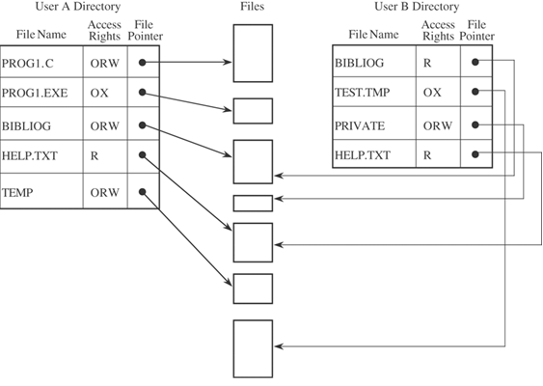
Directory Access Rights
Every file has unique owner
Each user has file directory which lists all the files which that user has access

Slide 79
Access Control Matrix
An access control matrix is a protection structure that provides efficient access to:
Access privileges of users to various files
Access control information for files
It’s a table in which each row represents a subject, each column represents an object, and each entry is the set of access rights for that subject to that object.

Slide 80
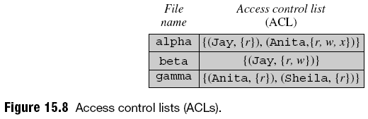
Access Control Matrix
In general, the access control matrix is sparse (meaning that most cells are empty):
Most subjects do not have access rights to most objects
The access matrix can be represented as a list of triples, having the form <subject, object, rights>.
Searching a large number of these triples is inefficient enough that this implementation is seldom used.

Slide 81
Access Control Matrix
 | BIBLIOG | TEMP | F | HELP.TXT | C_COMP | LINKER | SYS_CLOCK | PRINTER
USER A | ORW | ORW | ORW | R | X | X | R | W
USER B | R | - | - | R | X | X | R | W
USER S | RW | - | R | R | X | X | R | W
USER T | - | - | - | R | X | X | R | W
SYS_MGR | - | - | - | RW | OX | OX | ORW | O
USER_SVCS | - | - | - | O | X | X | R | W

Slide 82
Access Control List (ACL)
There is one ACL for each object
ACL shows all subjects who should have access to the object and what their access is.
One access control list per object; a directory is created for each subject.
Significant advantages
Consider subjects A and S, both of whom have access to object F. The operating system will maintain just one access list for F, showing the access rights for A and S
Access control list can include general default entries for any users.
In this way, specific users can have explicit rights, and all other users can have a default set of rights.
A public file or program can be shared by all possible users of the system without the need for an entry for the object in the individual directory of each user

Slide 83
ACL …
ACL of a file is a representation of its access control information
Contains the non-null entries that the file’s column would have contained in the ACM
The concept of ACLs was given in 70’s and the same was used in security device – Firewall in the 90’s

Slide 84
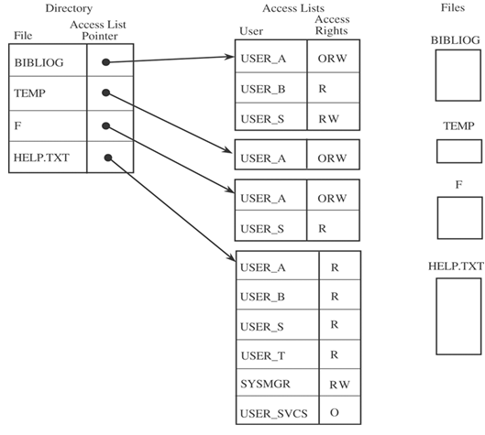
ACL Example

Slide 85
Protection Structures
Protection structure: classical name for the authorization database
Access privilege (for a file): right to make a specific form of access to the file
Access descriptor: representation of a collection of access privileges for a file
Access control information (for a file): collection of access descriptors

Slide 86
Cryptography
Cryptography (secret writing) is the strongest tool for controlling against many kinds of security threats.
Well-disguised data cannot be read, modified, or fabricated easily.
Encryption is a means of maintaining secure data in an insecure environment.

Slide 87
Terminology and Background
Consider the steps involved in sending messages
from a sender, S
to a recipient, R
If S entrusts the message to T, who then delivers it to R, T then becomes the transmission medium.
If an outsider, O, wants to access the message (to read, change, or even destroy it), we call O an interceptor or intruder.

Slide 88
Terminology
Encryption is the process of encoding a message so that its meaning is not obvious
Decryption is the reverse process, transforming an encrypted message back into its normal, original form.
Alternatively, the terms encode and decode or encipher and decipher are used instead of encrypt and decrypt
A system for encryption and decryption is called a cryptosystem.

Slide 89
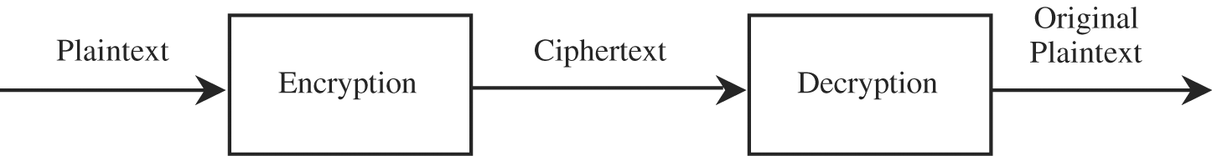
Terminology
The original form of a message is known as plaintext, and the encrypted form is called ciphertext.

Slide 90
Terminology
For convenience, we denote a plaintext message P as a sequence of individual characters
P = <p₁, p₂, …, p_{n}>.
Similarly, ciphertext is written as
C = <c₁, c₂, …, c_{m}>.
We write C = E(P) and P = D(C), where C represents the ciphertext, E is the encryption rule, P is the plaintext, and D is the decryption rule.
What we seek is a cryptosystem for which P = D(E(P)).
In other words, we want to be able to convert the message to protect it from an intruder, but we also want to be able to get the original message back so that the receiver can read it properly.

Slide 91
Encryption Algorithms
The cryptosystem involves a set of rules for how to encrypt the plaintext and how to decrypt the ciphertext.
The encryption and decryption rules, called algorithms, often use a device called a key, denoted by K, so that the resulting ciphertext depends on the original plaintext message, the algorithm, and the key value.
C = E(K, P)

Slide 92
Encryption Algorithms
It is useful to have a few well-examined encryption algorithms that everyone could use, but the differing keys would prevent someone from breaking into the asset being protected.

Slide 93
Encryption Algorithms
Sometimes the encryption and decryption keys are the same, so P = D(K, E(K,P)). This form is called symmetric encryption because D and E are mirror-image processes.
At other times, encryption and decryption keys come in pairs. Then, a decryption key, K_{D}, inverts the encryption of key K_{E} so that
P = D(K_{D}, E(K_{E},P)).
Encryption algorithms of this form are called asymmetric
An encryption scheme that does not require the use of a key is called a keyless cipher.

Slide 94
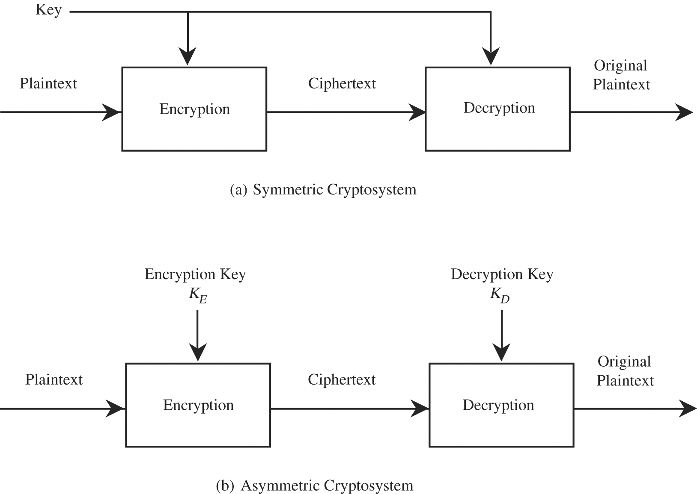
Encryption Algorithms

Slide 95
Cryptosystem
X’
Cryptanalyst
K’
X
Y
X
Message
Source
Encryption
Algorithms
Decryption
Algorithms
Destination
K
Key
Source
Secure channel

Slide 96
Cryptology
Cryptography means hidden writing, and it refers to the practice of using encryption to conceal text.
Cryptanalyst studies encryption and encrypted messages, hoping to find the hidden meanings.

Slide 97
Cryptology
Both a cryptographer and a cryptanalyst attempt to translate coded material back to its original form.
Normally, a cryptographer works on behalf of a legitimate sender or receiver, whereas a cryptanalyst works on behalf of an unauthorized interceptor.
Cryptology is the research into and study of encryption and decryption; it includes both cryptography and cryptanalysis.

Slide 98
Cryptanalysis
A cryptanalyst breaks an encryption.
Cryptanalyst attempts to deduce the original meaning of a ciphertext message.
Or determine which decrypting algorithm matches the encrypting algorithm so that other messages encoded in the same way can be broken.

Slide 99
Cryptanalyst can attempt to do …
Break a single message
Recognize patterns in encrypted messages, to be able to break subsequent ones by applying a straightforward decryption algorithm
Infer some meaning without even breaking the encryption, such as noticing an unusual frequency of communication or determining something by whether the communication was short or long

Slide 100
Cryptanalyst can attempt to do
Deduce the key, to break subsequent messages easily
Find weaknesses in the implementation or environment of use of encryption
Find general weaknesses in an encryption algorithm, without necessarily having intercepted any messages

Slide 101
Information needed by a cryptanalyst
A cryptanalyst works with a variety of pieces of information:
encrypted messages,
known encryption algorithms,
intercepted plaintext,
data items known or suspected to be in a ciphertext message,
mathematical or statistical tools and techniques,
properties of languages,
computers, and
plenty of ingenuity, luck and originality.

Slide 102
Information needed by a cryptanalyst …
Each piece of evidence can provide a clue, and the analyst puts the clues together to try to form a larger picture of a message's meaning in the context of how the encryption is done.

Slide 103
Attack models for the cryptanalysis
Ciphertext-only:
is an attack model for cryptanalysis where the attacker is assumed to have access only to a set of ciphertexts.
The attack is completely successful if the corresponding plaintexts can be deduced, or even better, the key.

Slide 104
Attack models for the cryptanalysis
Known-plaintext
is an attack model for cryptanalysis where the attacker has samples of both the plaintext and its encrypted version (ciphertext). These can be used to reveal further secret information such as secret keys.

Slide 105
Attack models for the cryptanalysis
Chosen-plaintext
is an attack model for cryptanalysis which presumes that the attacker has the capability to choose arbitrary plaintexts to be encrypted and obtain the corresponding ciphertexts.
The goal of the attack is to gain some further information which reduces the security of the encryption scheme.

Slide 106
Breakable Encryption
An encryption algorithm is called breakable when, given enough time and data, an analyst can determine the algorithm.
However, an algorithm that is theoretically breakable may in fact be impractical to try to break.
Ex., consider a 25-character message that is expressed in just uppercase letters. A given cipher scheme may have 26²⁵ (approximately 10³⁵) possible decipherments
If your computer could perform on the order of 10¹⁰ operations per second, finding this decipherment would require on the order of 10²⁵ seconds.
Infeasible to compute

Slide 107
Breakable Encryption
Two other important issues must be addressed when considering the breakability of encryption algorithms.
First, the cryptanalyst cannot be expected to try only the hard, long way.
ingenious approach might require only 10¹⁵ operations. => 10¹⁵ operations take slightly more than one day
Second, estimates of breakability are based on current technology.
Things that were infeasible in 1940 became possible by the 1950s
A conjecture known as "Moore's Law" asserts that the speed of processors doubles every 1.5 years, and this conjecture has been true for over two decades.
It is risky to pronounce an algorithm secure just because it cannot be broken with current technology, or worse, that it has not been broken yet.

Slide 108

Representing Characters
Consider encryption of messages written in the standard 26-letter English-alphabet, A through Z.
Convention: plaintext is written in UPPERCASE letters, and ciphertext is in lowercase letters
Expressions such as A + 3 = D or K - 1 = J have their natural interpretation.

Slide 109
Representing Characters
Arithmetic is performed as if the alphabetic table were circular (modulo arithmetic)
every result of an arithmetic operation is between 0 and 25
Ex. Y + 3 = B (and B – 3 = Y)
Two simple forms of encryption:
substitutions, in which one letter is exchanged for another
transpositions, in which the order of the letters is rearranged

Slide 110
Substitution Ciphers
The Caesar Cipher
c_{i} = E(p_{i}) = p_{i} + 3
A full translation chart of the Caesar cipher is shown here.
Using this encryption, the message
TREATY IMPOSSIBLE
would be encoded as
T R E A T Y I M P O S S I B L E
w u h d w b l p s r v v l e o h
The pattern p_{i} + 3 was easy to memorize and implement, however, it is easy break

Slide 111
Encryption algorithms
Two basic methods:
Substitution
Monoalphabetic ciphers
Polyalphabetic ciphers
Transposition (permutation)

Slide 112
Monoalphabetic Ciphers
Each letter is translated or substituted by a fixed letter after it in the alphabet.
e.g. Caesar Cipher uses a shift 3.
The plaintext letter pi is enciphered as ciphered letter by the rule.
ci = E(pi) = pi + 3
A translation chart of the Caesar cipher is as shown below.
Plain text ABCD E FG H IJKLMNOPQRSTUVWXYZ Cipher text defg h ij k lmnopqrstuvwxyzabc
e.g. Happy New Year would be kdssb qhz bhdu

Slide 113
Monoalphabetic Cipher Cryptanalysis
Some letters are used more often than others.
Example of the clues:
The letter E, T and A occur more than J, Q and Z
The break between the two words, the SS can be translated to VV
Therefore cryptanalysis uses such occurrence patterns to decipher the cipher text easily
Count do help to narrow the possibilities
The frequent occurring letters in the ciphertext are likely to be among the more frequently occurring letters in English

Slide 114
Polyalphabetic Cipher
The weakness of monoalphabetic cipher is that their frequency distribution reflects the distribution of the underlying alphabet.
A cipher that is more cryptographically secure would display flat distribution.
One way to flatten the distribution is to combine distribution that are high with that are low.
Uses multiple mappings between plaintext and ciphertext and it is not just a single mapping

Slide 115
Polyalphabetic Cipher
Example of mapping:
Odd position mapping
ABCDEFGHIJKLMNOPQR S T UVWXYZ…..
Adgjmpsvybehknqtwz c f ilorux
Even position mapping
ABCDEFGHIJKLMN O PQR S TUVWXYZ…..
Nsxchmrwbglqva f kpu z ejotydi
Example of text:
TREAT YIMPO SSIBL E → fumnf dyvtf czysh h

Slide 116
Transposition
Rearrange the order of bits, characters or blocks of characters that are being encrypted or decrypted.
The original letters of the plaintext are preserved; only their positions change.
e.g. Columnar Transposition
The rearrangement of the characters of the plaintext into columns
The resulting ciphertext is formed by traversing the columns

Slide 117
Columnar Transposition

Slide 118
Columnar Transposition
The plaintext is:
THIS IS A MESSAGE TO SHOW HOW A COLUMNAR TRANSPOSITION IS WORKING
The ciphertext is:
TAGO CASIR HMEW ORPOK IETH LTONS SSOO URSS ISSW MAIW SAHA NNTO

Slide 119
Stream Ciphers
Key (optional)
ISSOPMI wdhuw
Plaintext ciphertext
Encryption
It converts one symbol of plaintext immediately into a symbol of ciphertext
The transformation depends only on the symbol, the key, and control information of the encipherment algorithm
e.g. substitution encryption

Slide 120
Stream Ciphers - Advantages
Speed of transformation
Each symbol is encrypted without regard for any other plaintext symbols, each symbol can be encrypted as soon as it is read
Low error propagation
Each symbol is separately encoded, an error in the encryption process affects only that character

Slide 121
Stream Ciphers - Disadvantages
Low diffusion
Each symbol is separately enciphered
Susceptible to malicious insertions and modifications
Since, each symbol is separately enciphered, an active interceptor who has broken the code can splice together pieces of previous messages and transmit a spurious message that may look authentic

Slide 122
Block Ciphers
It encrypts a group of plaintext symbols as one block , e.g. 64 bits or more
It works on blocks of plaintext and produce blocks of ciphertext
e.g. transposition encryption

Slide 123
Block Ciphers - Advantages
Diffusion
Information from plaintext is diffused into several ciphertext symbols
One ciphertext block may be depend on several plaintext letters
Immunity of insertions
Since blocks of symbols are enciphered, it is impossible to insert a single symbol into one block
The length of the block would then be incorrect, and decipherment would reveal the insertion

Slide 124
Block Ciphers - Disadvantages
Slowness of encryption
Block ciphers must wait until an entire block of plaintext symbols has been received before sorting the encryption process
Error propagation
An error will affect the transformation of all other characters in the same block

Slide 125
Public Key Cryptosystem
Each end system in a network generates a pair of keys to be used for encryption and decryption of messages that it will receive
Each system publishes it’s encryption key by placing it in a public register or file. This is the public key. The companion key is kept private (eg. Verisign provide security service for international e-commerce, DigiCert mainly for local e-commerce)
If A wishes to send a message to B, it encrypts the message using B’s public key
When B receives the message, B decrypts it using B’s private key. No other recipient can decrypt the message because only B knows B’s private key.

Slide 126
Public Key - Advantages
All participants have access to public keys and private keys are generated locally by each participant and therefore need never be distributed
As long as system controls it’s private key, its incoming communication is secure
At any time, a system can change its private key and publish the companion public key to replace its old public key
It is computationally infeasible to deduce the private key from the public key
Anyone who has a public key can encrypt information but cannot decrypt it
Only the person who has the corresponding private key can decrypt the information

Slide 127
Public Key – Examples
Elgamal (named for its investor, Taher Elgamal)
RSA (named for its investors; Ron Rivest, Adi Shamir and Leonard Adleman)
Diffie-Hellman (named for its investors)
DSA – Digital Signature Algorithm (invented by David Kravitz)

Slide 128
Public Key Cryptosystem: Encryption
Alice’s public key ring: Joy, Mike, Bob etc
Bob’s private key
Bob’s public key
Plaintext
input
Plaintext
output
Encryption Algorithm
Decryption Algorithm
Transmitted chipertext
Encryption algorithm eg. RSA
Decryption algorithm (reverse of encryption algorithm

Slide 129
Public Key Cryptosystem: Authentication
Bob’s public key ring: Joy, Mike, Alice etc
Alice’s public key
Alice’s private key
Plaintext
input
Plaintext
output
Encryption Algorithm
Decryption Algorithm
Transmitted chipertext
Encryption algorithm eg. RSA
Decryption algorithm (reverse of encryption algorithm

Slide 130
Public Key Cryptosystem Applications
Source A
Source B
X
Y
Z
Y
X
Message source
Encryption Algorithm
Encryption Algorithm
Decryption Algorithm
Decryption Algorithm
Message dest.
Public Key A
Key pair source
Public Key B
Private Key A
Key pair source
Private Key B

Slide 131
Confusion and Diffusion
Two additional important concepts are related to the amount of work required to perform an encryption
An algorithm providing good confusion has a complex functional relationship between the plaintext/key pair and the ciphertext
it will take an interceptor a long time to determine the relationship between plaintext, key, and ciphertext
Ex1: Caesar cipher is not good for an analyst who deduces the transformation of a few letters can also predict the transformation of the remaining letters, with no additional information
Ex2: one-time pad is good because one plaintext letter can be transformed to any ciphertext letter at different places in the output

Slide 132
Confusion and Diffusion
Two additional important concepts are related to the amount of work required to perform an encryption
Confusion
Diffusion: distributing the information from single plaintext letters over the entire output

Slide 133
Uses of Encryption
Cryptographic Hash Functions
Key Exchange
Digital Signatures
Certificates

Slide 134
The Uses of Encryption
Encryption implements protected communications channels
it can also be used for other applications
Cryptographic Hash Functions, Key Exchange, Digital Signatures, Certificates
Public key algorithms are useful only for specialized tasks
very slow;
take long to perform as a symmetric encryption
underlying modular exponentiation depends on multiplication and division
slower than the bit operations (addition, exclusive OR, substitution, and shifting) on which symmetric algorithms are based

Slide 135
Cryptographic Hash Functions
For integrity purpose
One way computation
Reverse is very difficult

Slide 136
Cryptographic Hash Functions
MD4, MD5 (where MD stands for Message Digest)
MD5 is an improved version of MD4
Any message will have 128-bit digest
SHA/SHS (Secure Hash Algorithm or Standard).
it produces a 160-bit digest
Cryptanalysis attacks on SHA, MD4, and MD5
For SHA, the attack is to find two plaintexts that produce the same hash digest (collision)
2⁶³ steps, far short of the 2⁸⁰ steps that would be expected of a 160-bit hash function

Slide 137
Birthday Attack
In probability theory, the birthday problem or birthday paradox concerns the probability that, in a set of n randomly chosen people, some pair of them will have the same birthday.

Slide 138
Birthday Attack
By the pigeonhole principle, the probability of same birthday reaches 100% when the number of people reaches 367 (since there are 366 possible birthdays, including February 29).
However, 99% probability is reached with just 57 people, and 50% probability with 23 people.
These conclusions are based on the assumption that each day of the year (except February 29) is equally probable for a birthday.
The mathematics behind this problem led to a well-known cryptographic attack called the birthday attack, which uses this probabilistic model to reduce the complexity of cracking a hash function.

Slide 139
Birthday Attack
A list of 23 people, comparing the birthday of the first person on the list to the others allows 22 chances for a matching birthday, the second person on the list to the others allows 21 chances for a matching birthday, third person has 20 chances, and so on.
Hence total chances are: 22+21+20+....+1 = 253, so comparing every person to all of the others allows 253 distinct chances (combinations): in a group of 23 people there are (23 * 22) / 2 = 253 pairs.

Slide 140
Key Exchange
The problem of symmetric keys is almost circular:
To establish an encrypted session, you need an encrypted means to exchange kys.

Slide 141
Key Exchange
Use Public key cryptography:
Suppose S and R want to derive a shared symmetric key
k_{PRIV-S}, k_{PUB-S}, k_{PRIV-R}, and k_{PUB-R}, are the private and public keys for S and R, respectively
S chooses any symmetric key K
S sends E(k_{PRIV-S},K) to R
R takes S's public key, removes the encryption, and obtains K
Ooops, any eavesdropper who can get S's public key can also obtain K
let S send E(k_{PUB-R}, K) to R. Then, only R can decrypt K
Ooops, R has no assurance that K came from S
The solution is for S to send to R:
E(k_{PUB-R}, E(k_{PRIV-S}, K))

Slide 142
Key Exchange
Another key exchange approach
Diffie-Hellman key exchange protocol
S and R use some simple arithmetic to exchange a secret
They agree on a field size n and a starting number g
they can communicate these numbers in the clear
Each thinks up a secret number, say, s and r.
S sends to R g^{s} and R sends to S g^{r}
S computes (g^{r})^{s} and R computes (g^{s})^{r} ,which are the same, so g^{rs} = g^{sr} becomes their shared secret
computations are done over a field of integers mod n (omitted for simplicity)
Diffie-Hellman, however, does NOT provide authentication

Slide 143
Digital Signatures
A digital signature is a protocol that produces the same effect as a real signature:
It is a mark that only the sender can make
but other people can easily recognize as belonging to the sender

Slide 144
Digital Signatures
Two conditions
It must be unforgeable:
If person P signs message M with signature S(P,M), it is impossible for anyone else to produce the pair [M, S(P,M)]
It must be authentic: If a person R receives the pair [M, S(P,M)] purportedly from P, R can check that the signature is really from P
Only P could have created this signature, and the signature is firmly attached to M

Slide 145
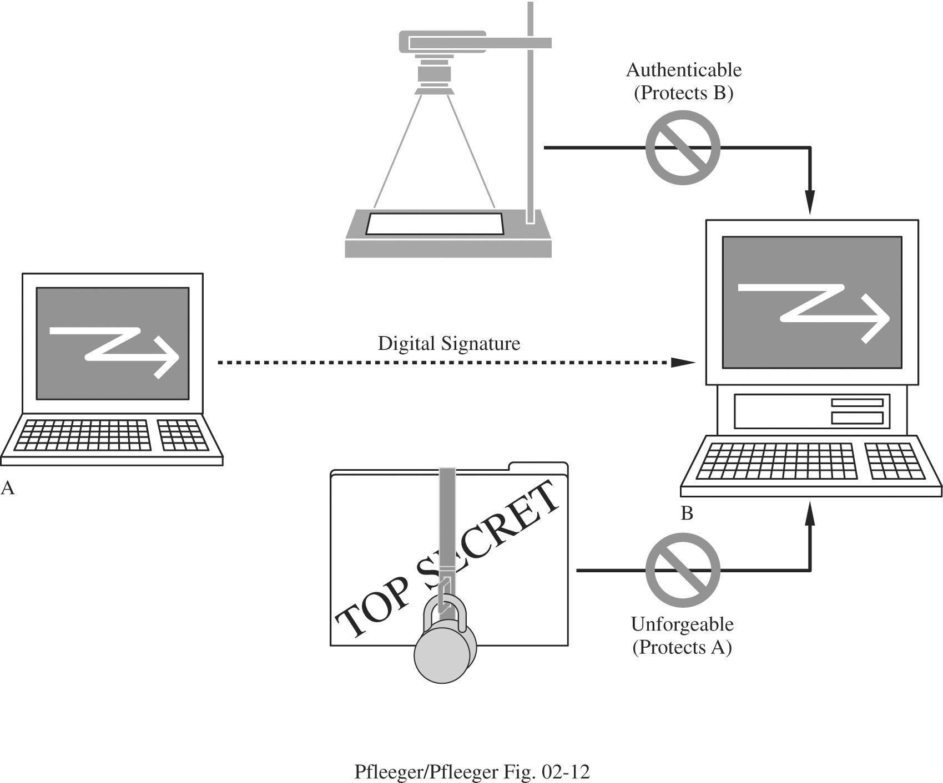
Digital Signatures

Slide 146
Digital Signatures
Two more properties
It is not alterable. After being transmitted, M cannot be changed by S, R, or an interceptor.
It is not reusable. A previous message presented again will be instantly detected by R.

Slide 147
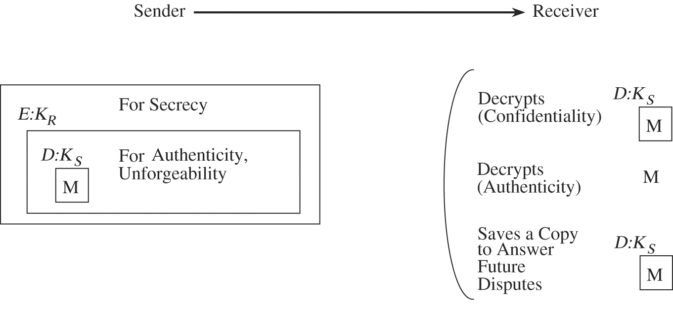
Digital Signatures
Public Key Protocol
ideally suited to digital signatures.
E: use the public key in transformation
D: use the private key in transformation

Slide 148
Certificates
A public key and user's identity are bound together in a certificate, which is then signed by someone called a certificate authority, certifying the accuracy of the binding.

Slide 149
Certificates
The algorithms to generate a matched pair of public and private keys are publicly known, and software that does it is widely available.
So if Alice wanted to use a public key cipher, she could generate her own pair of public and private keys, keep the private key hidden, and publicize the public key.
But how can she publicize her public key— assert that it belongs to her—in such a way that other participants can be sure it really belongs to her?

Slide 150
Certificates
A complete scheme for certifying bindings between public keys and identities— what key belongs to who—is called a Public Key Infrastructure (PKI).
A PKI starts with the ability to verify identities and bind them to keys out of band. By “out of band,” we mean something outside the network and the computers that comprise it, such as in the following scenarios.
If Alice and Bob are individuals who know each other, then they could get together in the same room and Alice could give her public key to Bob directly, perhaps on a business card.

Slide 151
Certificates
If Bob is an organization, Alice the individual could present conventional identification, perhaps involving a photograph or fingerprints.
If Alice and Bob are computers owned by the same company, then a system administrator could configure Bob with Alice’s public key.
A digitally signed statement of a public key binding is called a public key certificate, or simply a certificate

Slide 152
Certificates
One of the major standards for certificates is known as X.509. This standard leaves a lot of details open, but specifies a basic structure. A certificate clearly must include
the identity of the entity being certified
the public key of the entity being certified
the identity of the signer
the digital signature
a digital signature algorithm identifier (which cryptographic hash and which cipher)

Slide 153
Certificates
Certification Authorities
A certification authority or certificate authority (CA) is an entity claimed (by someone) to be trustworthy for verifying identities and issuing public key certificates.
There are commercial CAs, governmental CAs, and even free CAs.
To use a CA, you must know its own key. You can learn that CA’s key, however, if you can obtain a chain of CA-signed certificates that starts with a CA whose key you already know.
Then you can believe any certificate signed by that new CA

Slide 154
Links
https://cryptoclub.org/
https://www.schneier.com/academic/
https://school-for-champions.com
https://cse.sc.edu/isl/mysecurity
https://www.infosecawareness.in
https://isl.cse.sc.edu/mirrorSobireys.shtml
https://www.sicia-project.org/datenschutzerklaerung/

